Slide 1
CS4499/5599: Data Science and Applied Machine Learning
Class Lecture: April 24th, 2023

Slide 2
Objectives
Last time:
Clustering using DBSCAN
Image segmentation using K-Means
Dimensionality Reduction using PCA
Today:
Dimensionality Reduction with t-SNE
Hyperparamter Tunning
Gradient Descent

Slide 3
t-SNE
t-distributed stochastic neighbor embedding (t-SNE) is a manifold learning technique used to reduce dimensionality
The goal of t-SNE is to keep similar instances close, while keeping dissimilar ones apart
The most noteworthy advantage t-SNE has over other techniques like PCA is visualization
Like PCA, t-SNE is an unsupervised learning techniques, however the math if much more complex than the linear algebra techniques used for PCA
t-SNE is a nonlinear technique

Slide 4
t-SNE
t-SNE looks to identify patterns in the data using similarity
This similarity is based off conditional probabilities, which try to represent our higher dimension data in a lower dimension space
t-SNE then tries to minimize the sum of the differences between these probabilities for both the higher and lower dimensions
This is very computational expensive, a typical t-SNE will run in O(n²)

Slide 5
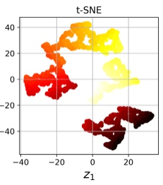
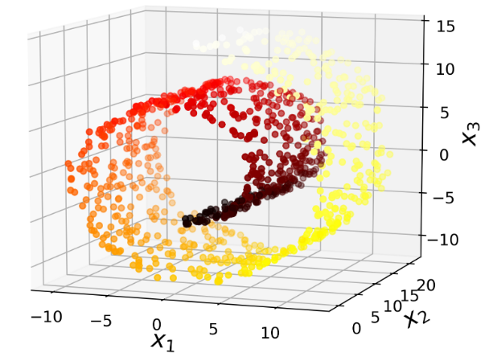
t-SNE
Compare the Swiss roll dataset we looked at last time when reduced using t-SNE

Slide 6
LLE
Locally Linear Embedding (LLE) is another nonlinear dimensionality reduction technique
This technique like t-SNE doesn’t rely on data projections
LLE measures how each training instance linearly relates to is closest neighbor (think something like kNN)
Then we look for a low dimensional representation of the data where the local relationships are best preserved
If there is little noise this can unroll manifolds well

Slide 7
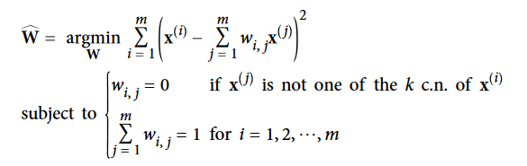
LLE
LLE works by reconstructing the feature point x^{i} as a linear function of the points neighbors
This is done using weights such that the distance between x^{i} and its neighbors is minimized
We can find the weights for all the neighbors using this equation:

Slide 8

LLE
The weights are then used to encode the relationship between training instances, this maps the instances into a smaller space
This is done with this equation:
Here we are just doing the reverse of the previous step, we have fixed weights, and we just look for a new position
As you can imagine this is very computationally expensive and is a poor choice for large datasets

Slide 9
Other Reduction Techniques
Random Projections: this is exactly how it sounds and works quite well. Quality depends on number instances rather than features
Multi-dimensional Scaling (MSD): reduces dimensionality while trying to preserve the distance between features
Isomap: uses the nearest neighbor's concept along with the geodesic distance to reduce dimensions
Linear Discriminate Analysis: a classification technique that learns the most discriminative axis and then projects data into that hyperplane

Slide 10
Hyperparameter Tunning
Throughout the class we have discussed various approaches that can be used to train ML models
Once you have trained your initial model, you may feel that your model is not performing as well as you would like
The final step in training effective models is to adjust your hyperparameters to train the optimal model
The only way to find the best values for your hyperparameters is to try them all
However, as your models become more complex, the training time increases, and this is not feasible

Slide 11
Grid Search
A popular approach for hyperparameter tunning is a Grid Search
Sklearn’s GridSerachCV will try out a range of hyperparameters values (specified by the use) using cross validation
The more parameters and higher range you use, the longer it will take to evaluate

Slide 12
Grid Search
Consider a random forest model with the following hyperparameters and ranges:
n_estimators: =[3,10,30]
max_features: [2,4,6,8]
How many combinations will this try?
If needed, we can specify multiple dictionaries of hyperparameters and ranges to better tune our search
By default, when sklearn finds the best estimator, it will retrain the model on the entire dataset
Using the .best_estimator function will return the optimal values for all your hyperparameters

Slide 13
Randomized Search
Randomized Search is a good alternative to Grid Search if you have a large hyperparameter space
As the name suggest we perform a Grid Search, but instead of trying out all the possible combinations, we evaluate a given number of random combinations
This gives us more control of our search and allows us to manage our time and computational power
Also, we can perform a more extensive search across more possible values
The sklearn class for Randomized Search is sklearn.model_selection.RandomizedSearchCV

Slide 14
Gradient Descent
There are techniques we can use that will get us ‘close’ to the optimal value for our hyperparameters
The most common of these is Gradient Descent, where we will slightly adjust our values to minimize a lost function
Gradient Descent measure the local gradient of an error function with respect to a vector of values θ, and when the gradient reach 0 we have the minimum
In practice our vector θ contains random values, then we approach one small step at a time until we converge to a minimum value

Slide 15
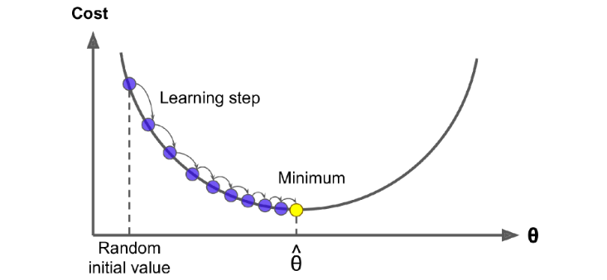
Gradient Descent
One thing we must consider is the learning rate (how big our step is), to small and it will take time, too large and we may miss the minimum

Slide 16
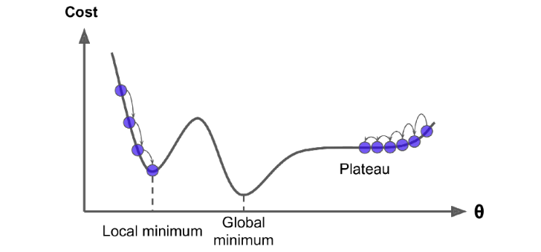
Gradient Descent
Note that our cost function does not have to be quadratic, it can have many hills and valleys
For linear regression this won’t be an issue (this is a convex function), but keep it in mind

Slide 17
Gradient Descent
Gradient Descent is most common with neural network models and deep learning, but the concept is applied in many areas in machine learning
Many neural network packages such as TensorFlow will let you add Gradient Descent when you train your model
There are several types of Gradient Descent:
Batch Gradient Descent (Uses all the data at each step)
Stochastic Gradient Descent (Faster, but may not converge)
Mini-Batch Gradient Descent (Fast, sensitive to local minimums)

Slide 18
Next Time
Finish Dimensionality Reduction:
Discuss Pipelines
High Performance Computing
The role of CPUs/GPUs in machine learning
Remember:
No class on Wednesday 4/26
Graduate Presentations will be on 5/1 at 5:30 PM
Graduate papers will be due on 5/3 by 5:00 PM
The undergraduate final project will be due on 5/3 by 5:00 PM

